Slide 1
Module 6
Graphs theoretic algorithms - Algorithm for computer representation of a graph, algorithm for connectedness and components, spanning tree, shortest path.

Slide 2
Computer Representation of Graphs
A graph is generally presented to and is stored in a digital computer in one of the following forms:
Adjacency Matrix:
Adjacency matrices are the mostly used form to represent a graph in computers.
Assigning distinct numbers to the distinct vertices of G, the n X n-binary matrix X(G)is used for representing G during the input, storage and output.
Since each of the n² entries are either a 0 or a 1, the adjacency matrix requires n² bits of computational memory.

Slide 3
As bits can be packed into words, each row of the adjacency matrix of G of order n may be written as a sequence of n bits in [n/w] machine words, where w is the word length (number of bits in a computer word).
Therefore, the number of words required to store the adjacency matrix is n [n/w].

Slide 4
But note that this increases the complexity and computation time, even though the storage space is saved.
Another point is that adjacency matrix is defined for the graphs without parallel edges, this method cannot be used for representing graphs with parallel edges.

Slide 5
Incidence Matrix:
Incidence matrices are also used to represent graphs. It requires n X e bits of storage which might be more than the storage space required for the adjacency matrix (it is because the number of edges may be greater than the number of vertices in a vast majority of graphs).
In certain practical cases such as electrical networks and switching networks incidence matrices are preferred than the adjacency matrices.

Slide 6
Edge Listing:
Another way to represent a graph is just a list, or array, of |E| edges, which is called an edge list.
Clearly, parallel edges and self-loops can be included in this representation of a graph.
Note that if we require b bits of storage for a vertex, then storing an edge requires 2b bits. (Since an edge can be considered to be the pair of its end vertices).
Therefore, the total storage required will be 2b.E.
The following example illustrates the edge-listing of the graph in Figure

Slide 7
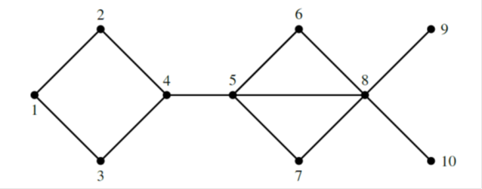
The edge list of the graph in Figure above is written as: L_{E} = {1-2,1-3,2-4,3-4,4-5,5-6,5-7,5-8,6-8,7-8,8-9,8-10}.
Edge listing is comparatively a convenient method for inputting a graph into the computer, but the retrieval and manipulation may be more difficult.

Slide 8
Two Linear Arrays:
In this method, a graph is represented in two linear arrays, say F and H of vertices of the graph G, not necessarily disjoint, such that each edge has one end vertex in F and other in H.
This method is found useful to represent weighted graphs and has the same storage requirements as that for edge listing.

Slide 9
The two-linear array of the graph in Figure above is written in the table given below:
Successor Listing:
This method can efficiently be used for representing those graphs with e/n ratio is small.
Here, n linear arrays are used to represent the vertices and their successors in G.

Slide 12
For example, by writing the list “i : j,k, l”, it is meant that the vertices with labels j,k and l are successors of the vertex with label i.
For undirected graphs, neighbours are listed and hence each edge will appear twice in the list. This is an obvious redundancy.

Slide 13
Algorithm for Connectedness and Components
Given the adjacency matrix of a graph G, is it possible to determine whether the graph Gis connected?
If not connected, what is the number of components in G? The following algorithm checks the connectedness of graphs.
Connectedness and Components Algorithm
1 : Set H = G and component count c = 1.
2 : Choose an arbitrary vertex v of G.

Slide 14
S-3 : Fuse all vertices in the neighbourhood N(v) with v and call this vertex v.
S-4 : If the number of vertices which are non-adjacent to v is the same as that before the fusion, then go to Step-5. Otherwise, go to Step-2.
S-5 : Delete the vertex v (with all fused vertex) from H call this new graph H.
S-6 : If H has any vertex left in it, then let c c+1 and go to Step-2. Otherwise, go toStep-7.
S-7 : Print each c with its vertices. Stop.

Slide 16
Set c=1 and choose v= v1.Fuse the vertices v2,v3,v5,v6 to v and call the new vertex v. Then we have the following graph.

Slide 17
Now number of vertices that are non-adjacent to v is different before and after the fusion.
So we repeat the action. Next we fuse v8 and v10 to v. and get the following reduced graph.

Slide 18
Here also, the number of vertices that non-adjacent to v is different before and after fusion.
So, in the next iteration, fuse the vertex v12 to v = v1. Then, we have the reduced graph as shown in Figure given below.

Slide 19
Now the number of vertices non-adjacent to v is same before and after fusion.
So, we can delete the vertex v1 from H and set c ← c+1(c=2).
Now take v = v4 in the reduced graph H and fuse the adjacent vertices v7 and v11 to v. Then, we have the reduced graph as shown in Figure below.

Slide 20
At this stage, it can be noted that the number of vertices that non-adjacent to v is different before and after fusion and hence we perform the same action again. That is, we fuse the vertex v14 to v. Then we get the reduced graph as shown in following figure.

Slide 21
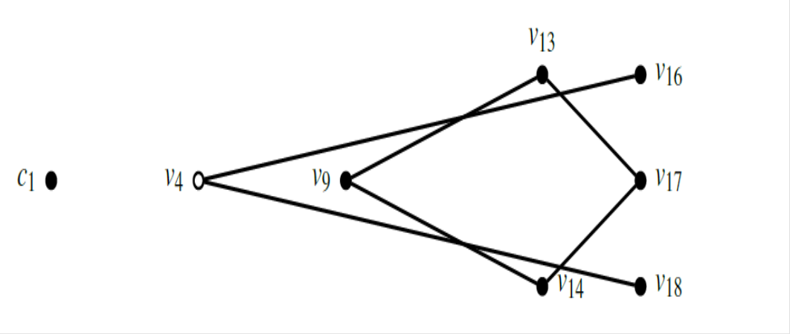

Slide 22
Here also, the number of vertices that are non-adjacent to v is different before and after fusion and hence we fuse the vertex v16 and v18 to v.
Then, v becomes an isolated vertex (non-adjacent vertices same before and after fusion) and hence we can delete v from H.
In the new reduced graph H, take v = v9 and set c = 3.
Fuse the vertices v13 and v15 to v.
Then, we have the reduced graph as given in the figure below.

Slide 23
Finally fusing the vertex v16 to v, we have

Slide 24
So the graph was disconnected with 3 components.

Slide 25
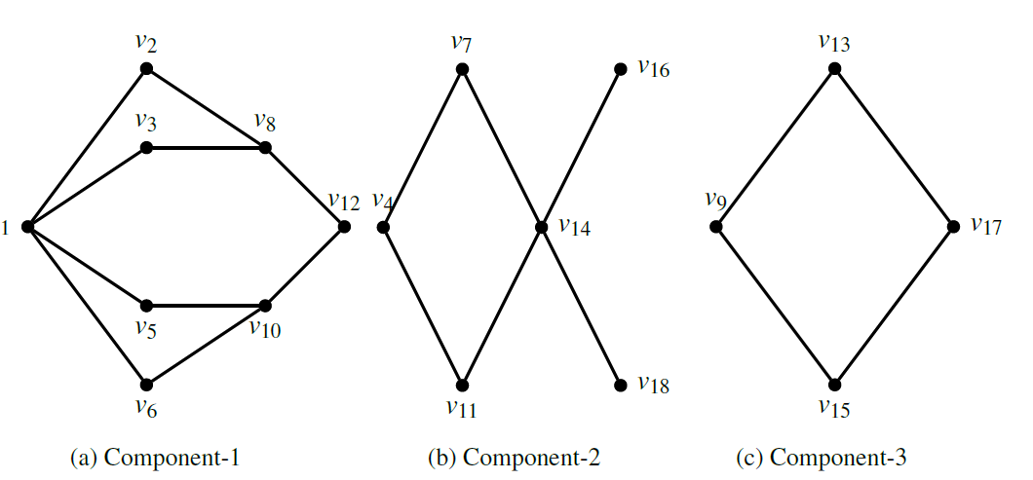

Slide 27
Spanning tree Algorithms
A spanning tree algorithm is the one which yields a spanning tree from a given connected graph and spanning forest from a given disconnected graph.
By this algorithm we can find out whether a graph is connected or not, and if it is disconnected ,the number of components in the graph.

Slide 28
Description of the algorithm
Let the given undirected self-loop free graph G contains n vertices and e edges. Let the vertices be labelled 1,2,3,…n and the graph be described by two linear arrays F and H such that are the end vertices of i^{th} edge in G.
At the each stage in the algorithm a new edge is tested to see if either or both of its end vertices

Slide 29
appear in any tree formed so far.
At the kth stage 1≤k≤e, in examining the edge (f_{k}, h_{k} ) five different conditions may arise.

Slide 31
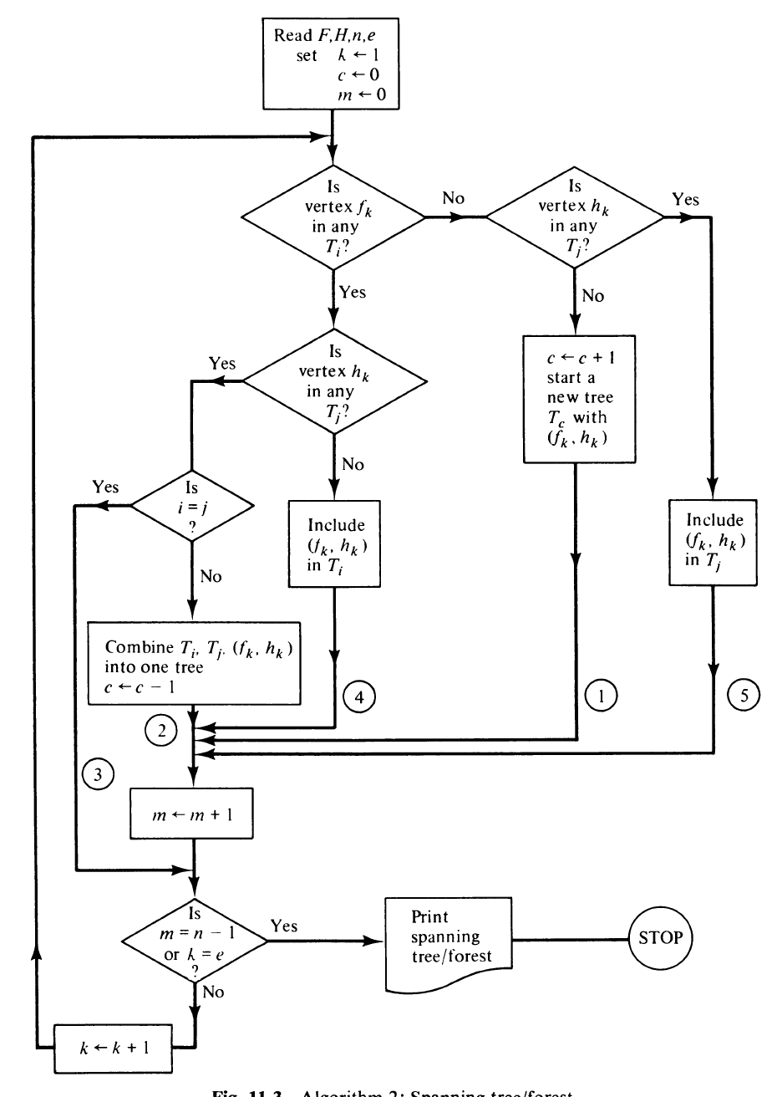

Slide 32
Shortest Path Problems
Different types of shortest path problems are there.
Shortest path between two specified vertices.
Shortest path between all pairs of vertices.
Shortest path from a specified vertices to all others. etc..

Slide 33
Shortest path from a specified vertex to another specified vertex
The problem of finding the shortest path from a specified vertex s to another specified vertex t can be stated as follows:
A simple weighted graph G of n vertices is described by an n by n matrix D = [d_{ij} ], where
d_{ij} = the length(or distance or weight) of the directed edge from vertex to vertex j. dij≥0.
d_{ii}=0
d_{ij}=∞ , if there is no edge from i to j.

Slide 34
Dijkstra’s Algorithm:
The algorithm labels the vertices of the given digraph.
The algorithm begins by assigning a permanent label 0 to the starting vertex s, and a temporary label ∞ to the remaining n-1 vertices.
From then on, in each iteration another vertex gets a permanent label according to the following rules.
Every vertex j that yet not permanently labelled gets a new temporary label whose value is given by:
min[old label of j, old label of i+d_{ij}]

Slide 35
where i is the latest vertex permanently labelled in the previous iteration, and d_{ij} is the direct distance between vertices i and j. If i and j are not joined by an edge then d_{ij}=∞.
The smallest value among all the temporary labels is found, and this becomes the permanent label of the corresponding vertex. In case of any tie select any one of the candidate for permanent labelling.
Steps 1 and 2 are repeated alternately until the destination vertex t gets a permanent label.

